Slide 1
Square Cities
Final Demo
John Stimac

Slide 2
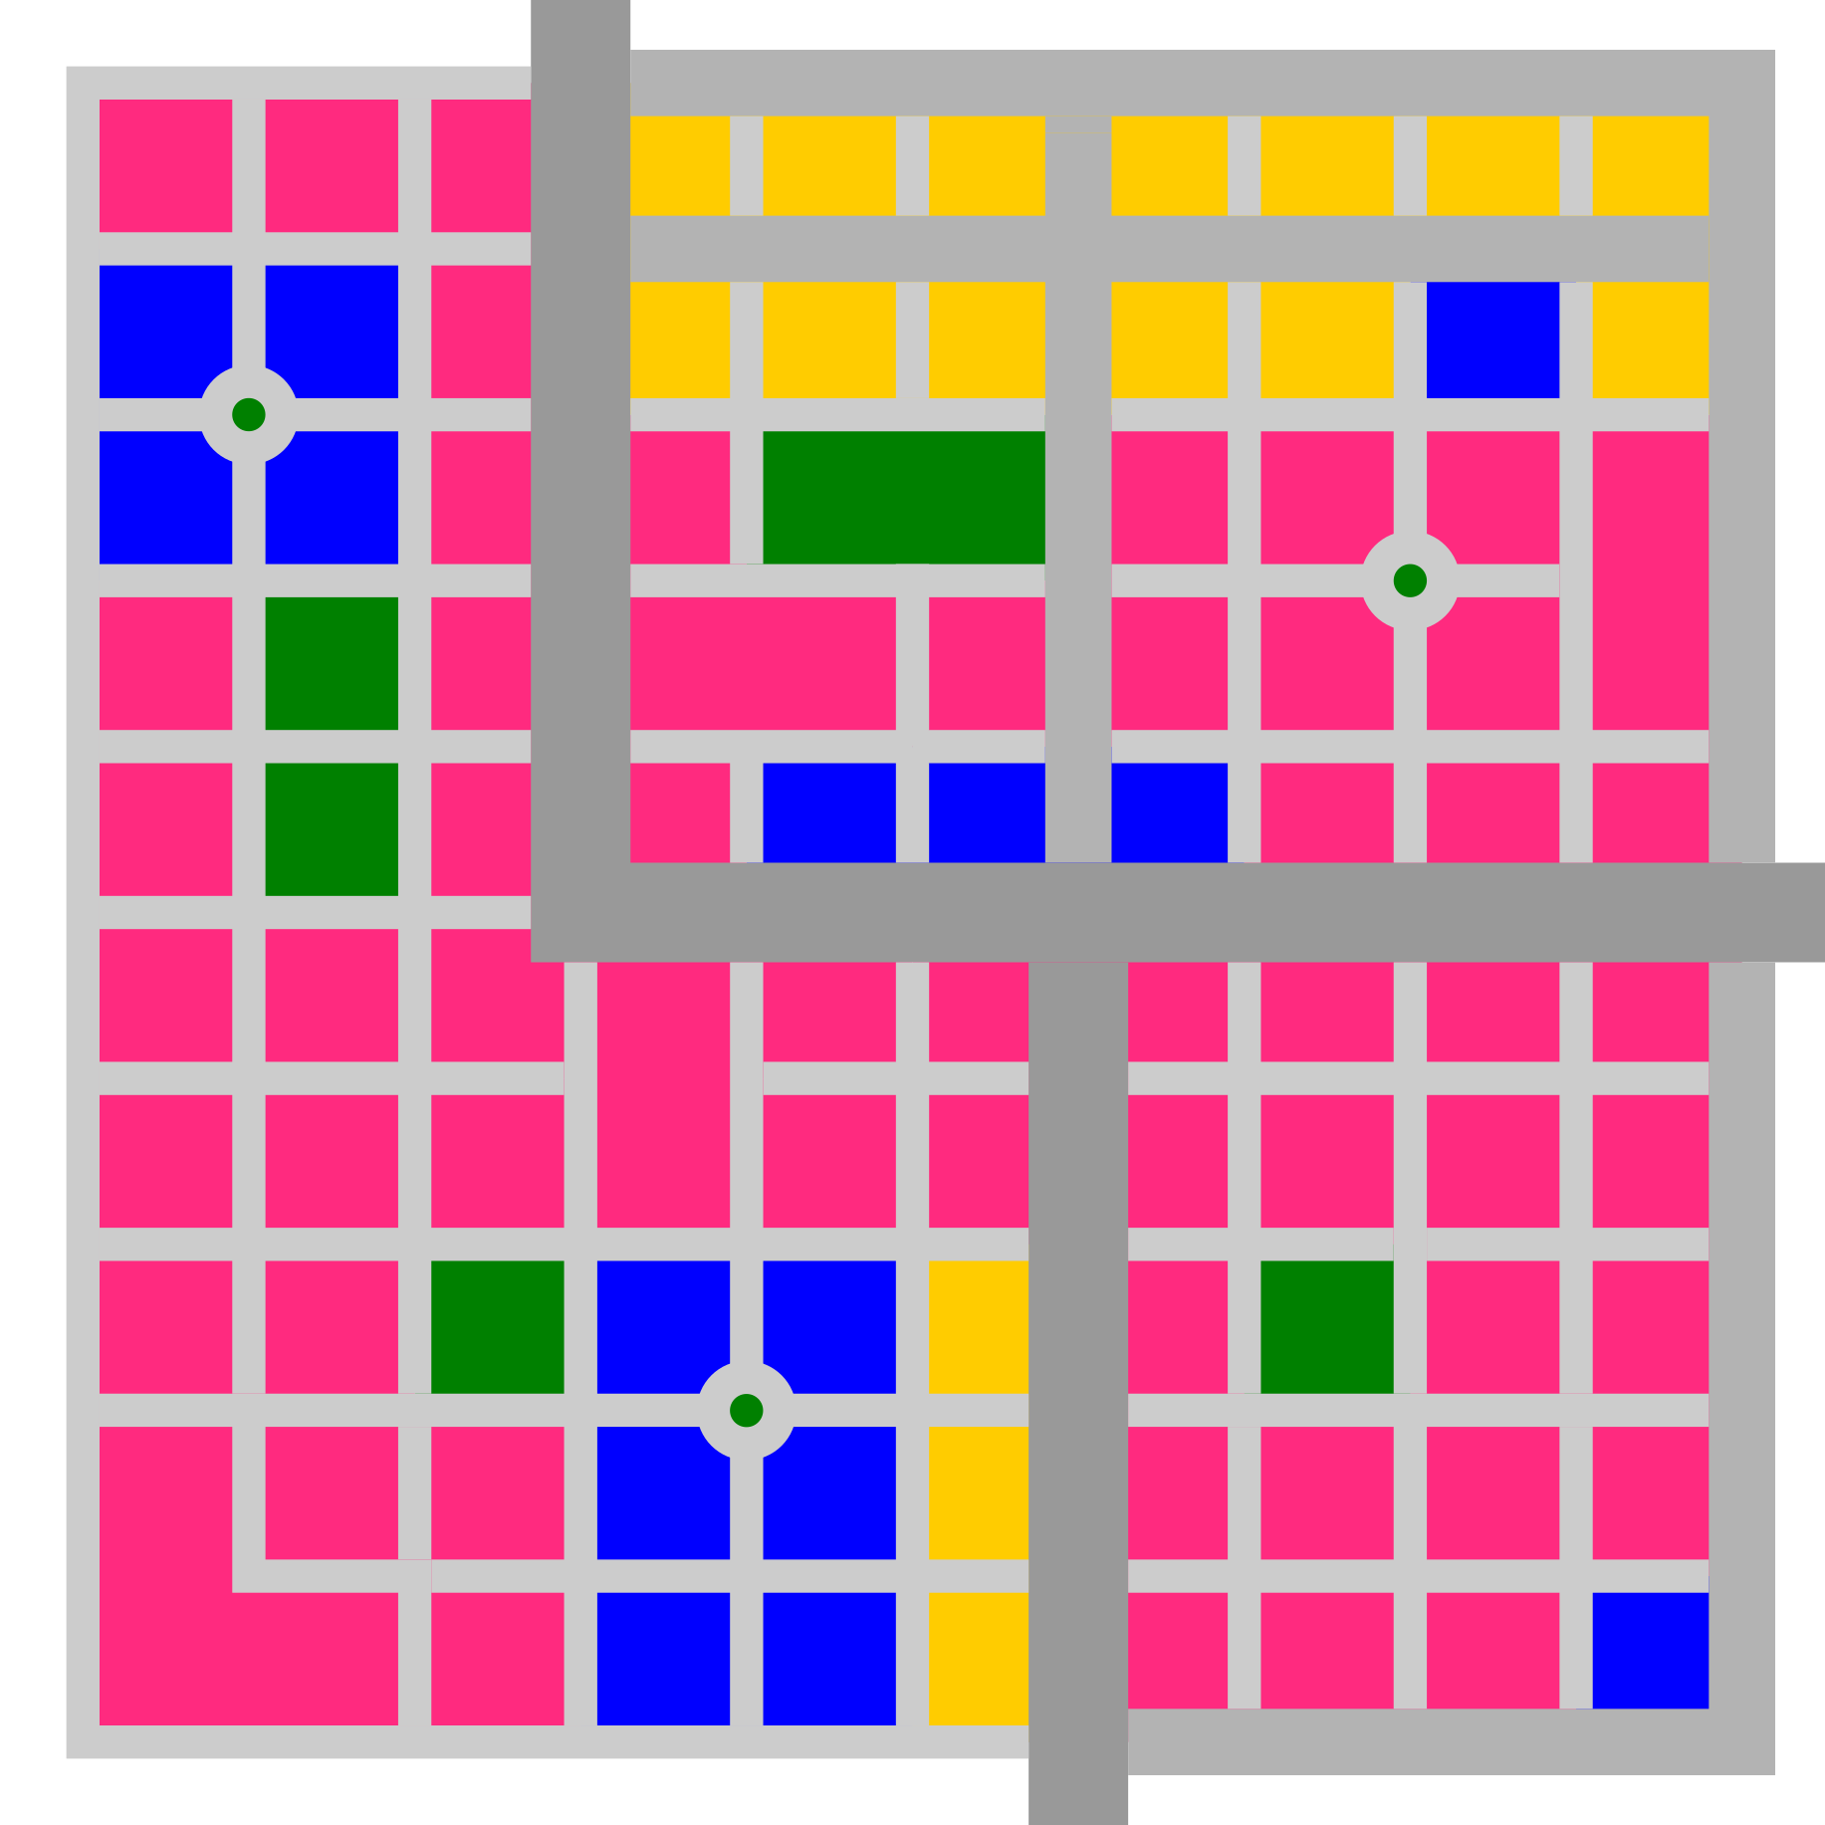
The Goal
Use procedural generation to generate roads in the form of a city
Concept Sketch

Slide 3
Motivation
Realism isn’t always the primary goal
Regularity can make development faster
Stylized results are sometimes preferable

Slide 4
Demo Time!

Slide 5
Prior Work
Most city layouts in games are built by hand
Looks more realistic, but at the cost of development time and simplicity
Current works don’t have the ability to be generated on the fly

Slide 6
Desired Features
3 different widths of road
3 types of intersections
Stop Lights
Stop Signs
Roundabouts
4 types of city zone
Residential
Commercial
Industrial
Green Space
Road Artwork
Lane markings
Intersection markings

Slide 7
Approach
Start with a grid of empty roads
Add a highway that connects one side of the grid to another
Add large roads that go across the whole grid
Add small roads, with a chance for some spots to remain empty
Make some regular intersections into traffic circles
Zone each cell based on its proximity to the center
Add buildings to each cell based on its zone

Slide 8
View
Github:
https://goo.gl/dTNhL6
Live Demo:
https://jstimac.com/squareCities/

Slide 9
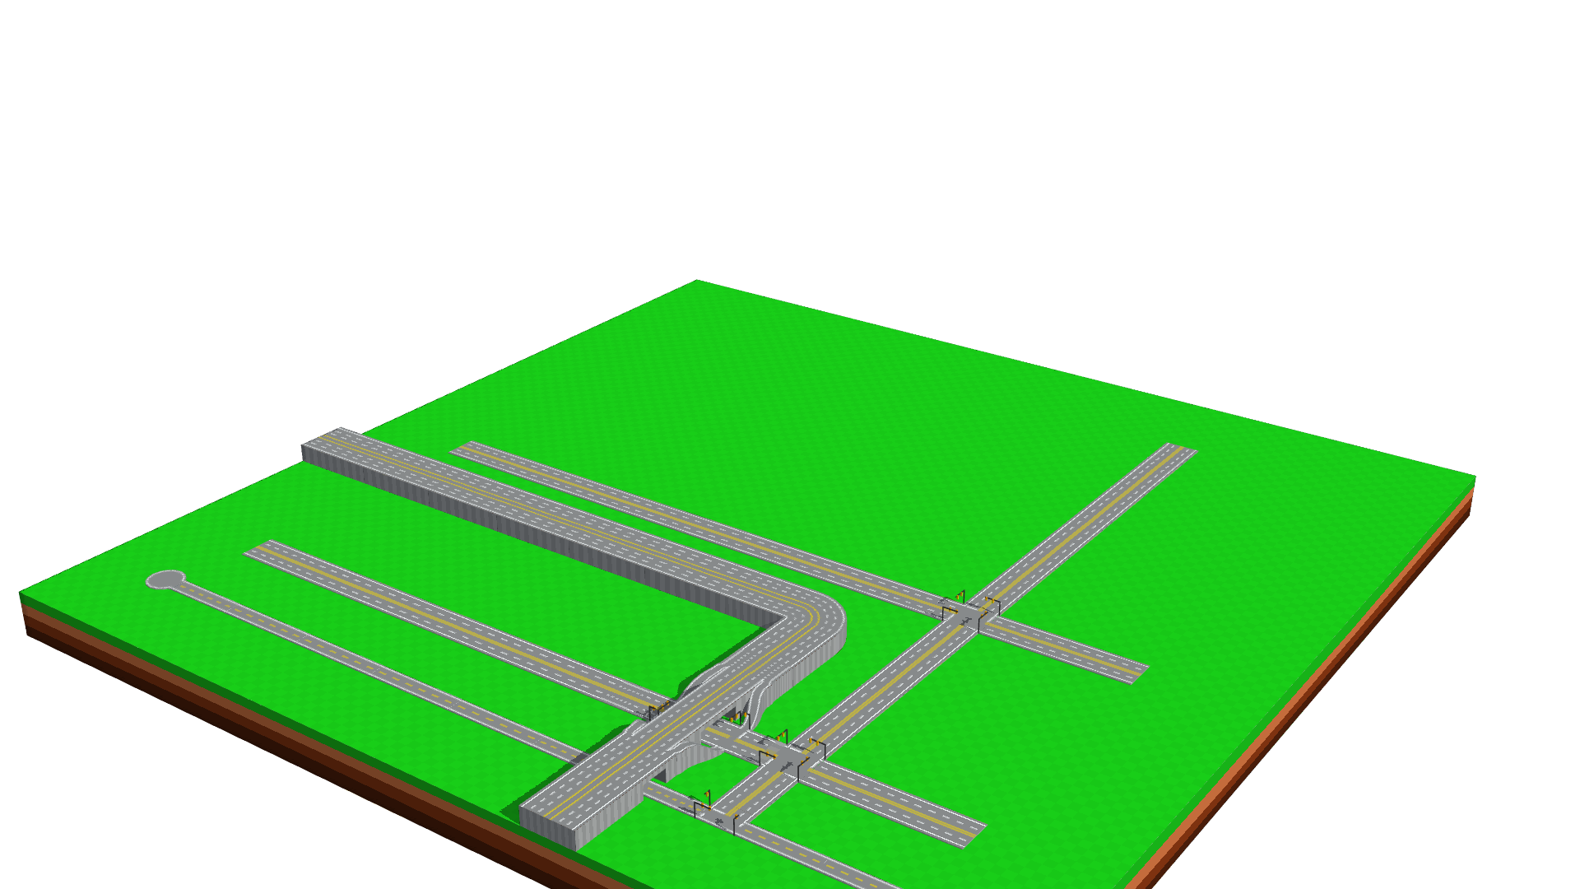

Slide 10
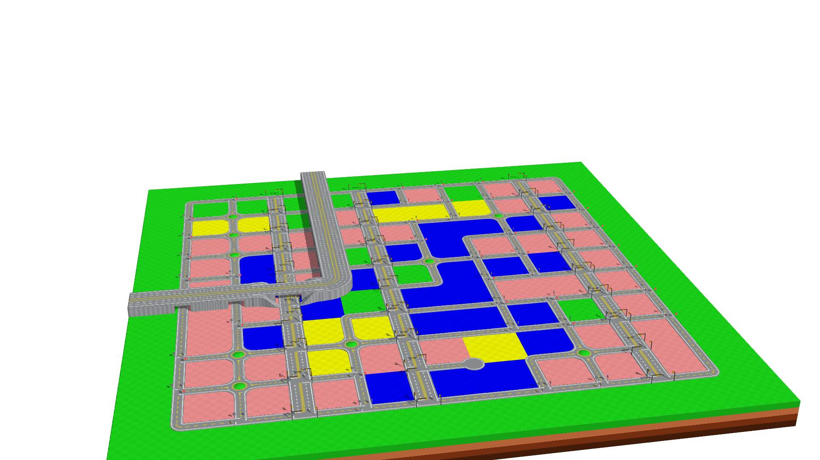

Slide 11
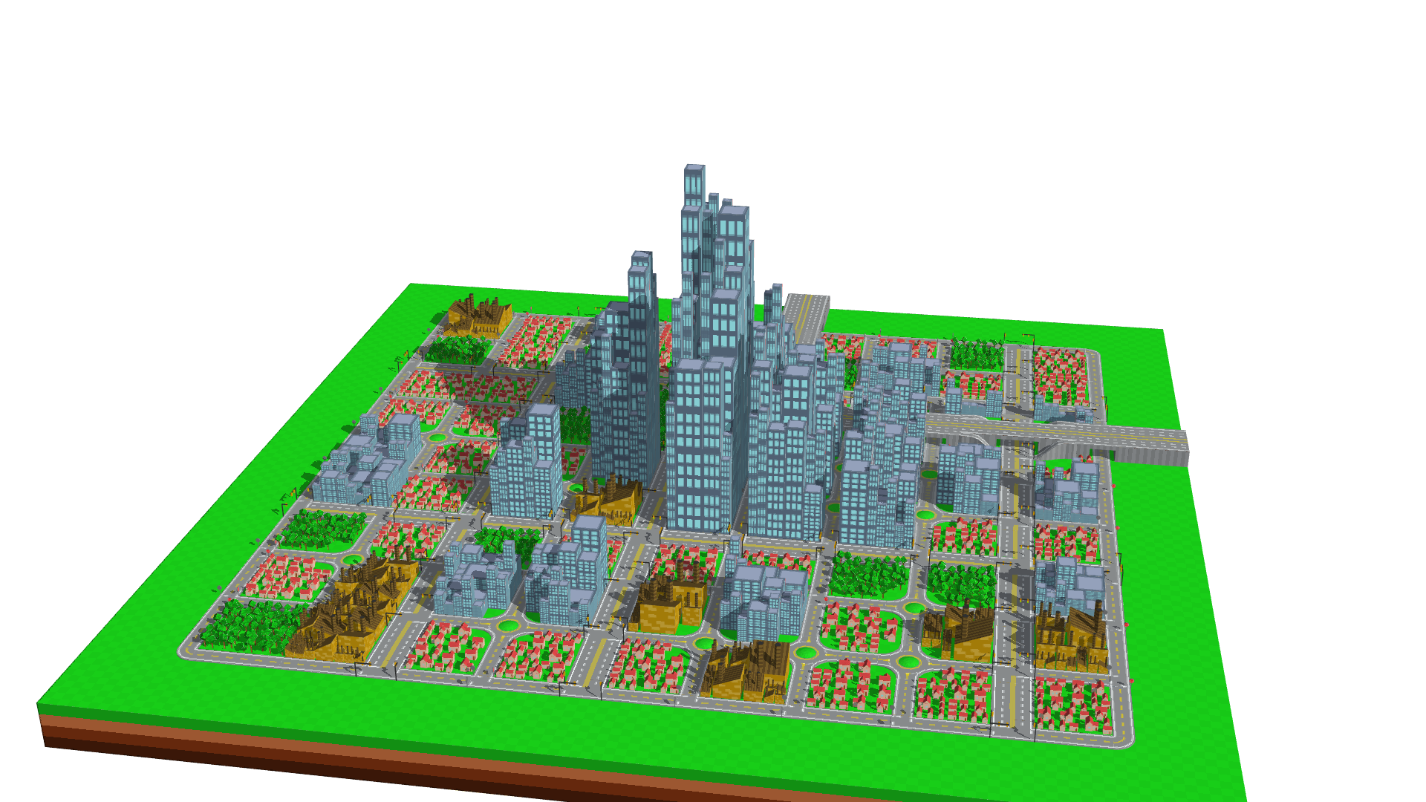

Slide 12
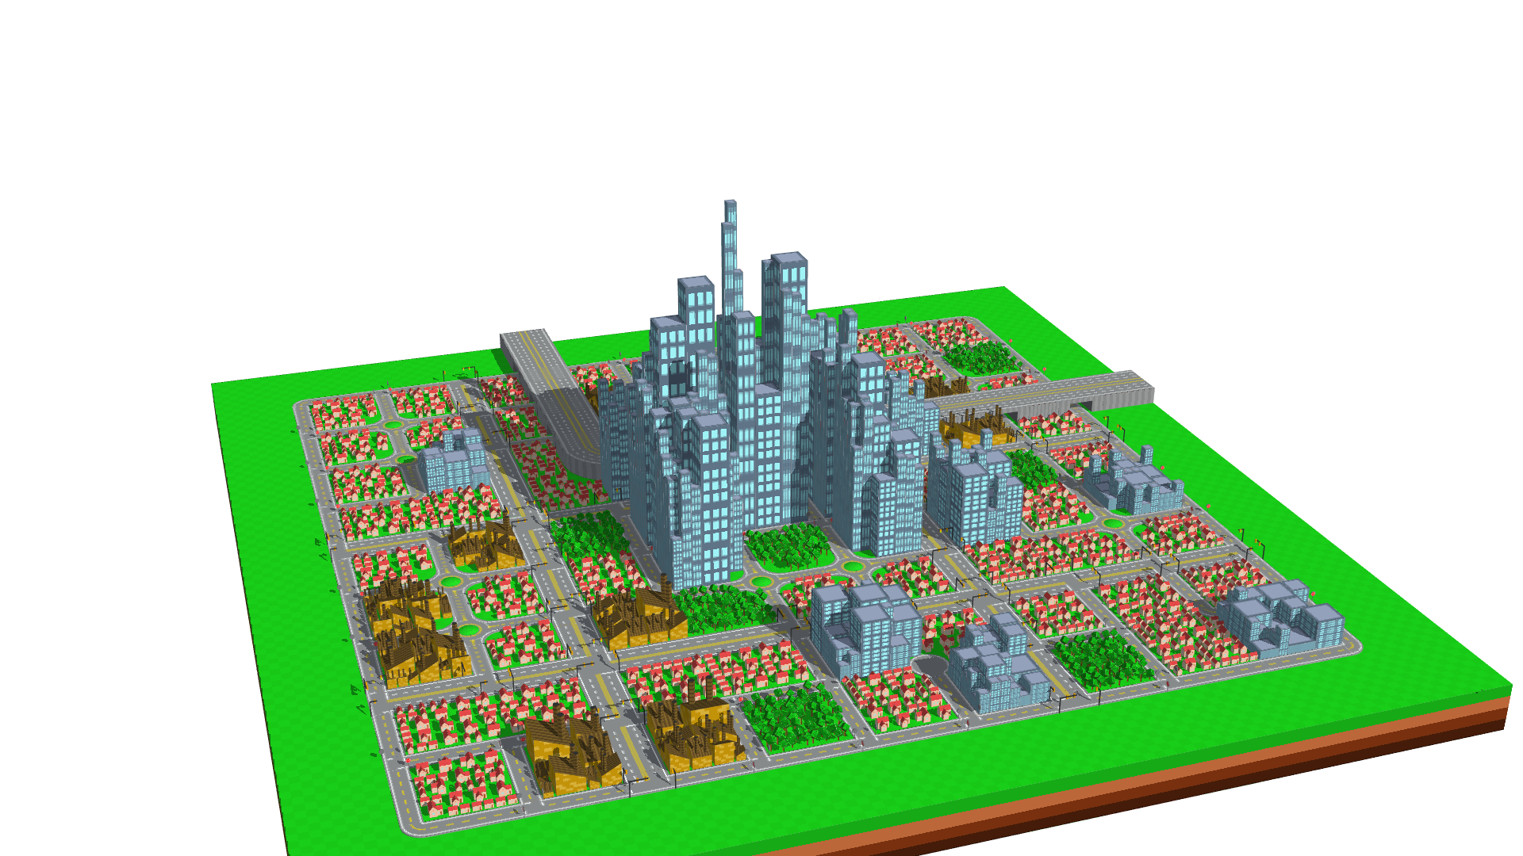

Slide 13
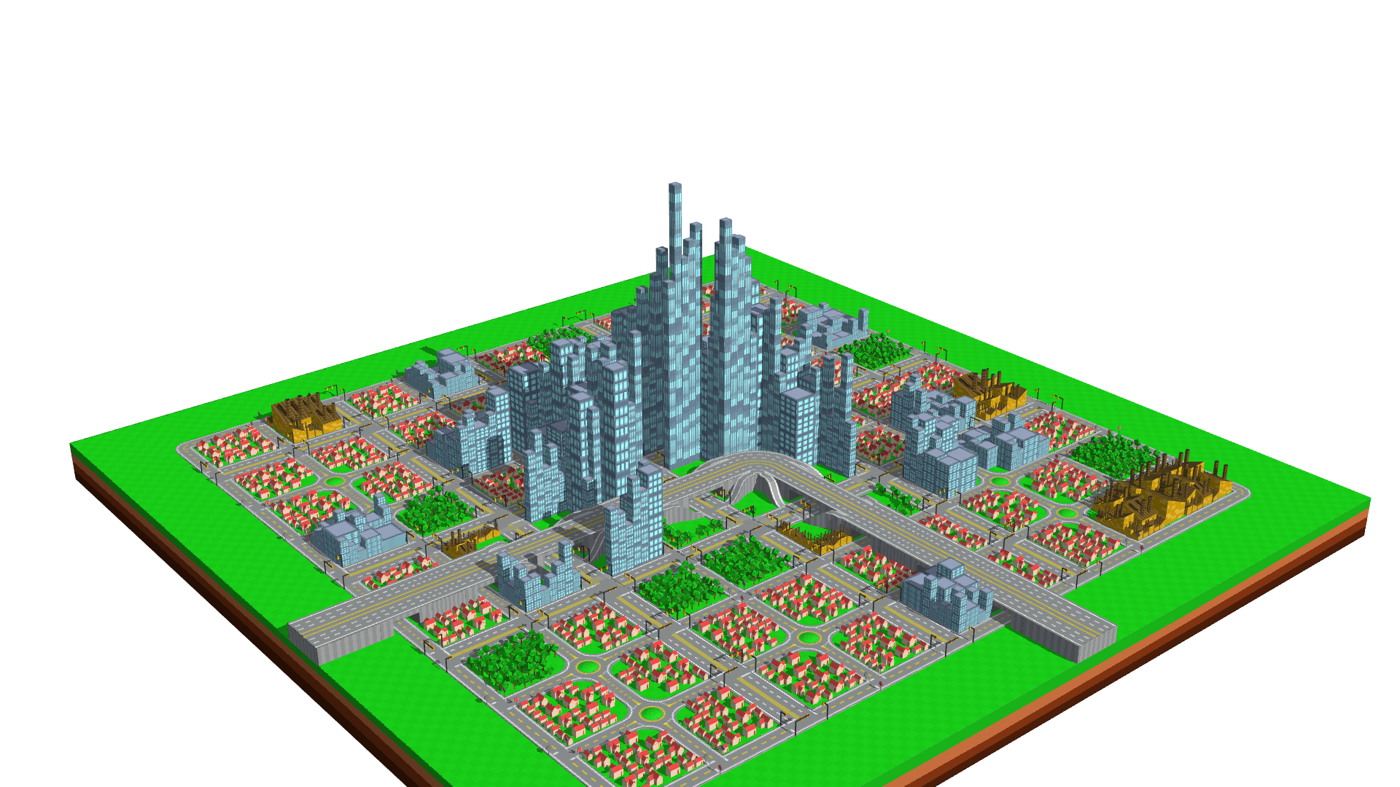

Slide 14
